Slide 1


A spoken corpus of Cameroon Pidgin English: Compilation, applications and next steps
Melanie Green, Sussex (UK)
Gabriel Ozón, Sheffield (UK)
Philological Society Meeting, 19 January 2019

Slide 2
Outline
Overview of the project
  About the language
  Research context
  Objectives & research team
  Pre-pilot corpus
  Pilot corpus
Case studies: working with small data
  Grammar
  Lexis
  Codeswitching
Next steps: towards a 1-million-word spoken corpus

Slide 3
About the language
Cameroon Pidgin English is an expanded pidgin/creole spoken in some form by an estimated 50% of Cameroon’s 22,000,000 population (Simons & Fennig 2017)
Spoken primarily in the Anglophone west regions, but also in urban centres throughout the country
As a predominantly spoken language, CPE has no standardised orthography, but enjoys a vigorous oral tradition, not least through its presence in the broadcast media
Stigmatised status in the face of French and English, prestige languages of Cameroon, where it also co-exists with an estimated 280 indigenous languages (Simons & Fennig 2017)

Slide 4
Research context (datasets)
Corpus of Cameroon English (under construction since 1994)
  Written standard Cameroon English
  Over 800,000 words (fiction, student essays, press coverage, government documents, advertisements, etc.)
  Tiomajou (1993), Nkemleke & Mbangwana (2007)
International Corpus of English (since 1996)
  ICE-NIGERIA (2014)
  Wunder, Voormann, and Gut (2010)
Corpus of written British Creole (1999)
  Collection of letters (c.12,000 words)
  Sebba, Kedge and Dray (1999)
APiCS (Atlas of Pidgin and Creole Language Structures, 2013)
  Michaelis, Maurer, Haspelmath and Huber (eds.) (2013)
NaijaSynCor (under construction since 2017)
  500K word corpus (spoken and written)
  Data collected from 8 different locations
  100K words with ‘deep’ annotation (POS tags, dependency parsing, prosodic annotation)
  http://naijasyncor.huma-num.fr/

Slide 5
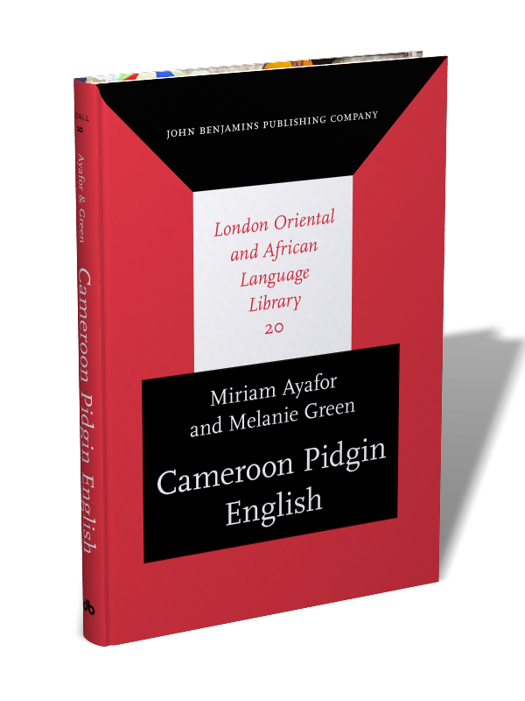
Objectives & research team
Objectives
  Piloting data collection and annotation
  Documentation: Dataset for grammatical description
  Provision of open access resource
Research team
  Dr Miriam Ayafor (Yaoundé I)
  Sarah FitzGerald (Sussex)
  Dr Melanie Green (Sussex)
  Dr Gabriel Ozón (Sheffield)

Slide 6
Pre-pilot corpus
Pre-pilot corpus of spoken CPE (unpublished, 2014)
  15 hours’ recording (Bamenda and Yaoundé)
  Unstructured interviews, monologues, dialogues, radio recordings
  c.120,000 words
  Transcribed but not annotated/tagged
Allowed costings and timings for funded pilot corpus
Allowed development of transcription-based orthography
Although a convenience sample, provided a robust testbed for preliminary linguistic hypotheses

Slide 7
Pilot corpus
A spoken corpus of CPE: Pilot study (Green et al. 2016 , Ozón et al. 2017)
http://ota.ox.ac.uk/desc/2563
30 hours’ recording in five locations (2 in Anglophone region, 3 in Francophone region)
240,000 words (80 texts of 15 minutes/3,000 words)
Proportions guided by the International Corpus of English project (Nelson 1996)
Mark-up and part-of-speech-tagging
Corpus files include:
  Sound files (mp3 and wav)
  Raw/annotated text files
  Participant metadata
  Field manual
  Tagging manual
  Spellings list

Slide 8
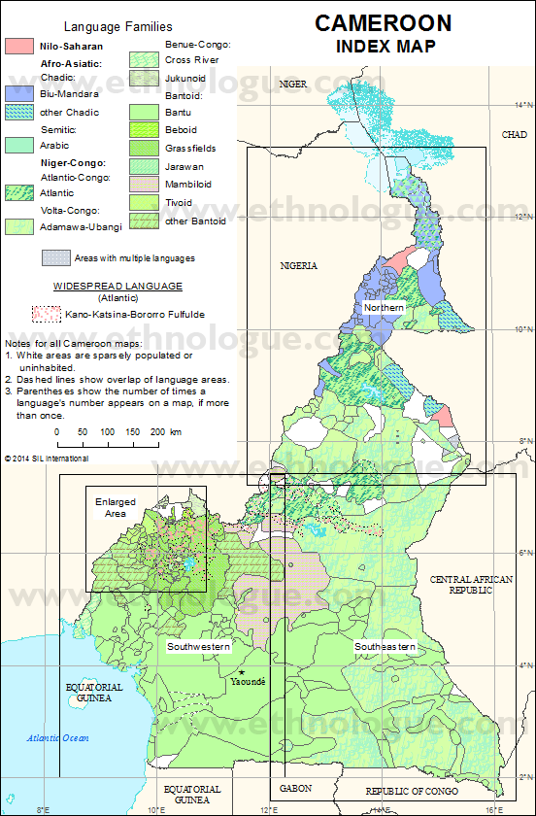
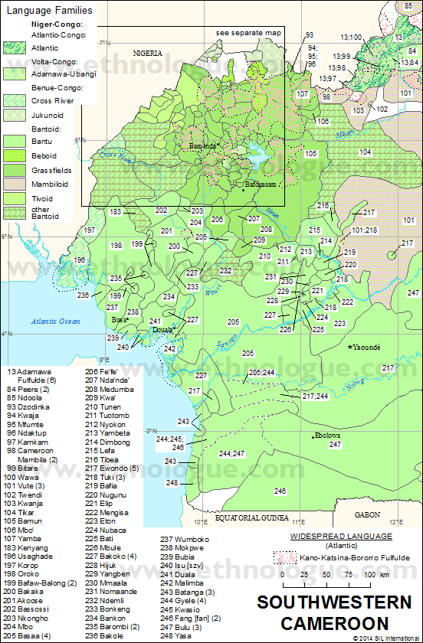
Kumba
Bertoua

Slide 9
Pilot corpus: Mark-up and tagging
Mark-up based on ICE coding for spoken texts (Nelson 2002)
Mark-up symbols identify
  Speakers
  Utterance numbers
  Overlapping speech
  Uncertain transcriptions
  Foreign words (French and English)
  Indigenous words (local languages)
Searchable identifiers, allowing fast automatic retrieval
Tagging used modified CLAWS tagset (Garside 1987): 52 tags
Automatic tagger (Tree Tagger, Schmid 1994) trained on manually tagged CPE data: 94% accuracy rate
POS-tagging distinguishes between different functions of the same form (e.g. foe as preposition or as infinitive marker)
Notes:
Indig/foreign
In keeping with ICE categories
Not without challenges (what is English but not CPE )
Transcriber intuition; criteria: English if word is not known to most CPE speakers

Slide 10
Pilot corpus: Mark-up and tagging
Raw
Ba_DPr_01 <$01-EN-M-B> 18
dat man get manquant foe dat sait foe bisnes foe plang
‘That man is unlucky when it comes to the timber business.’
Markup added (manually)
dat man get <foreign>manquant</foreign> foe dat sait foe bisnes foe plang
Ba_DPr_01 <$01-EN-M-B> 52
pleis wei dem di wok <indig>njamanjama</indig>
Tagging added (automatically)
dat_DTD man_NN0 get_VB0 <foreign> manquant_FOR </foreign> foe_PRF dat_DTD sait_NN0 foe_PRF bisnes_NN0 foe_PRF plang_NN0
Notes:
(Ba_DPr_01 0:47)
We provide both raw (readable) and annotated (searchable) texts, to cater for various research objectives

Slide 11
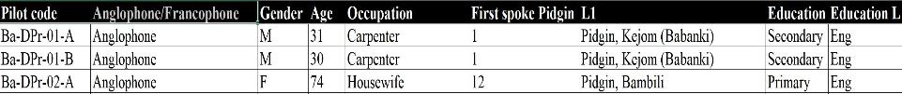
Pilot corpus: Metadata
Participant information
Gender
Age
Ethnic group
L1(s)
Education
Medium of education
(Full list available in corpus download)
Speaker ID codes
Speaker number in participant file matches speaker ID in corpus files
Speaker ID is a composite of various sociolinguistic categories
For example, our first speaker is <$01-EN-M-B>
Age groups: A (18-21), B (22-34), C (35-49), D (50-74)
Notes:
-Participant info: list is a subset, the file contains much more information (e.g. L1s of parents, CPE first spoken when, etc)
-Speaker ID codes: new development, will become available in the next release of the corpus
-Age groups: A (18-21), B (22-34), C (35-49), D (50-74)

Slide 12

Ba_DPr_02
<$04-EN-F-B>
1 Mami, da wan na reli long stori.
2 Bikos eh, fes of ol, de ticha wei dey fes gif mi wan, a noe di fes laik mi de ticha, a noe di fes laik mi de <foreign>supervisor</foreign>.
3 Bikos foe ol ma kos dem foe level fo, a di eva rait dat madam yi tes feil.
4 A di teik na…na difren seshon, a reli pas deiy fain, den a kova dat yi oun, den foe de tu kos dem nau a get mi pas mak, a <foreign>validate </foreign>mi de kos.
5 Wan madam goe kam klas, i stan, i tel yu sei i noe goe gi noe note.
6 As i di <foreign>lecture </foreign>, yu di teik ya notes.
7 Yu goe rid nau, yu get ya oun difren <foreign>definition </foreign> foe som ting, som man get yi oun difren <foreign>definition </foreign>.
8 Wen yu rait nau, noe madam di mak na de wan wei i si sei i deiy foe yi het?
9 <ant>cough </ant> yes.
10 Ivin if yu don goe rid yu som ya buk, yu get ya oun difren <foreign>definition </foreign> foe deiy, noe i goe soe soe dinai yi?
11 Bikos i nova rid da buk an i noe nou ting wei yu di tok abaut.
Notes:
Flavour of the language
Orthographic spellings
What can be done with the sound files

Slide 13
Case studies: Working with small data
Grammatical constructions
Zoom in: na copula/focus particle
Zoom out: GIVE ditransitive, comparison with CCE, ICE-NIGERIA
Lexis (exploratory research)
Zoom in: most frequent word/tag queries
Zoom out: most frequent word/tag queries, comparison with CCE, ICE-NIGERIA
Codeswitching (exploratory research)
By combining mark-up information with metadata, it is possible to explore the social meaning of codeswitching

Slide 14
Grammatical constructions: na copula/focus particle
Grammaticalisation chain from copula to focus marker (e.g. Harris and Campbell 1985, Harris 2001, Green 2007)

Slide 15
Grammatical constructions: na copula/focus particle
na was coded as:
CLEFT
  na yi wei a di trai=am nau soe
  ‘So it’s that which I’m trying now.’
COP
  na copular clause with overt subject and predicate
  yi neim na Mary
  ‘Her name is Mary.’
CPD
  na copular clause with subject pro-drop
  na bad fashon
  ‘It’s bad behaviour.’
CPS
  na copular clause with postposed subject
  na de problem dat
  ‘That’s the problem.’
FOC (here, in-situ object focus)
  where na functions as a focus marker within a verbal clause that is not a cleft
  a di kuk na dat bins
  ‘I’m cooking those beans.’

Slide 16
Grammatical constructions: na copula/focus particle
na occurs over half the time as a focus marker (significantly more when we take into account its use in cleft constructions), and 39% of the time in non-verbal copular clauses
Of the focus constructions marked by na, the overwhelming majority of those cases correspond to in-situ focus (68%), while only 14% correspond to ex-situ focus, and 18% are cases of subject focus
Green & Ozon (2018)

Slide 17
Grammatical constructions: na copula/focus particle
The distribution of na is consistent with the profile of a grammaticalisation chain
Genuine grammaticalisation can be distinguished from ‘apparent’ grammaticalisation in the sense of Bruyn (2009)
Apparent grammaticalisation is a type of substrate influence, a process that Heine & Kuteva (2005) call ‘polysemy copying’: copying the beginning and end stages of the grammaticalisation chain in the substrate language(s), and mapping them onto corresponding categories in the pidgin/creole language

Slide 18
Grammatical constructions: GIVE ditransitives
According to Schröder (2013), in the case of GIVE ditransitives, CPE speakers favour the indirect-object construction (DAT, 70%) over the double-object construction (DOC, 30%)
(DAT) a don bai som buk dem foe yu
‘I have bought some books for you.’
(DOC) a don bai yu som buk dem
‘I have bought you some books.’
Searches in our CPE corpus, however, suggest the opposite pattern: for GIVE ditransitives, DOC is the preferred pattern (74%) over DAT (26%)
Ozon et al (2017)
Notes:
-APiCS: serious limitations in accuracy and completeness (one informant)
-Corpora (even this small) address this: e.g. SVC Benefactive with GIVE are deemed to be impossible, and yet we found quite a few examples, from 7 different speakers, in different text types

Slide 19
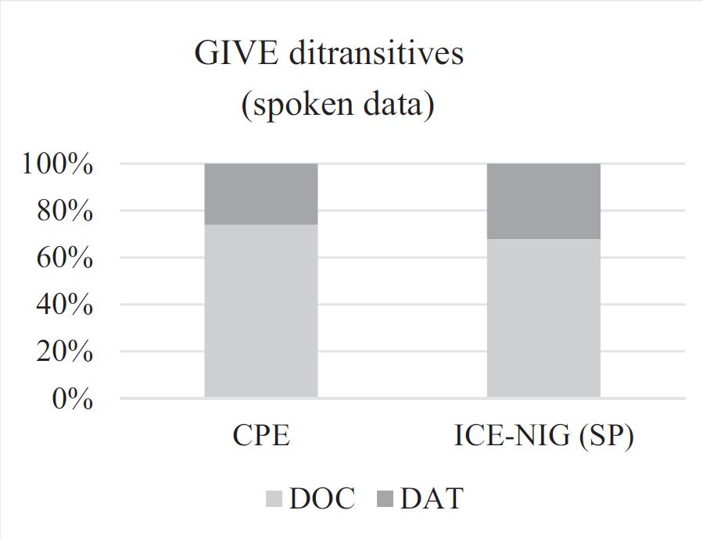
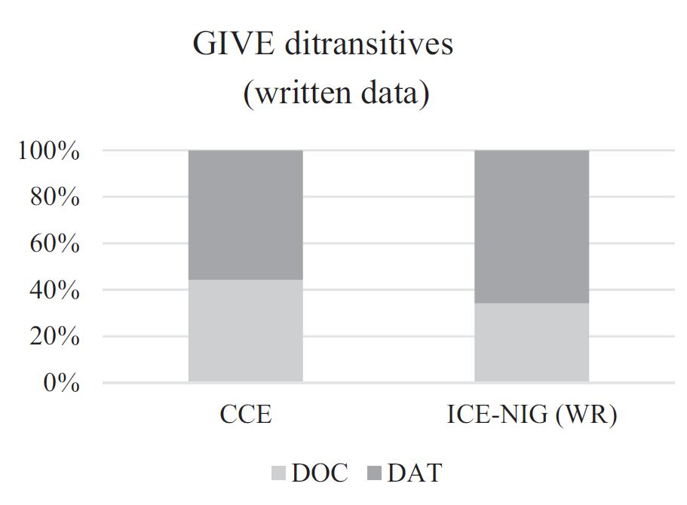
Grammatical constructions: GIVE ditransitives
CPE speakers’ preference for the DOC pattern mirrors that of speakers in ICE-NIGERIA
But CCE results patterns quite closely with the written component of ICE-NIGERIA
The findings correlate not with region, but rather with mode of communication (spoken vs. written)
Ozon et al (2017)
Notes:
Maybe what explains this is how standardised the variety is? NO

Slide 20
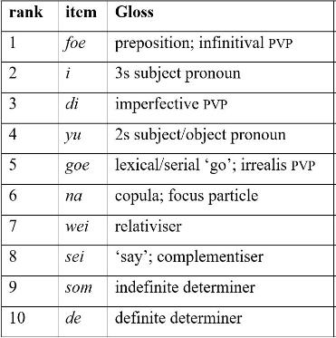
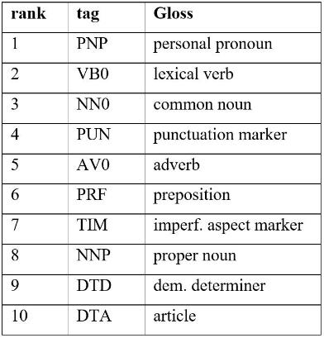
Lexis: most frequent word/tag queries (CPE)
Most frequent words in spoken CPE corpus
Most frequent tags in spoken CPE corpus
Ozon et al (2019)
Notes:
High proportion of multifunctional items
CPE list is heavily populated by grammatical elements such as determiners, pronouns and preverbal particles, and this offers a snapshot of the typological character of the language.

Slide 21
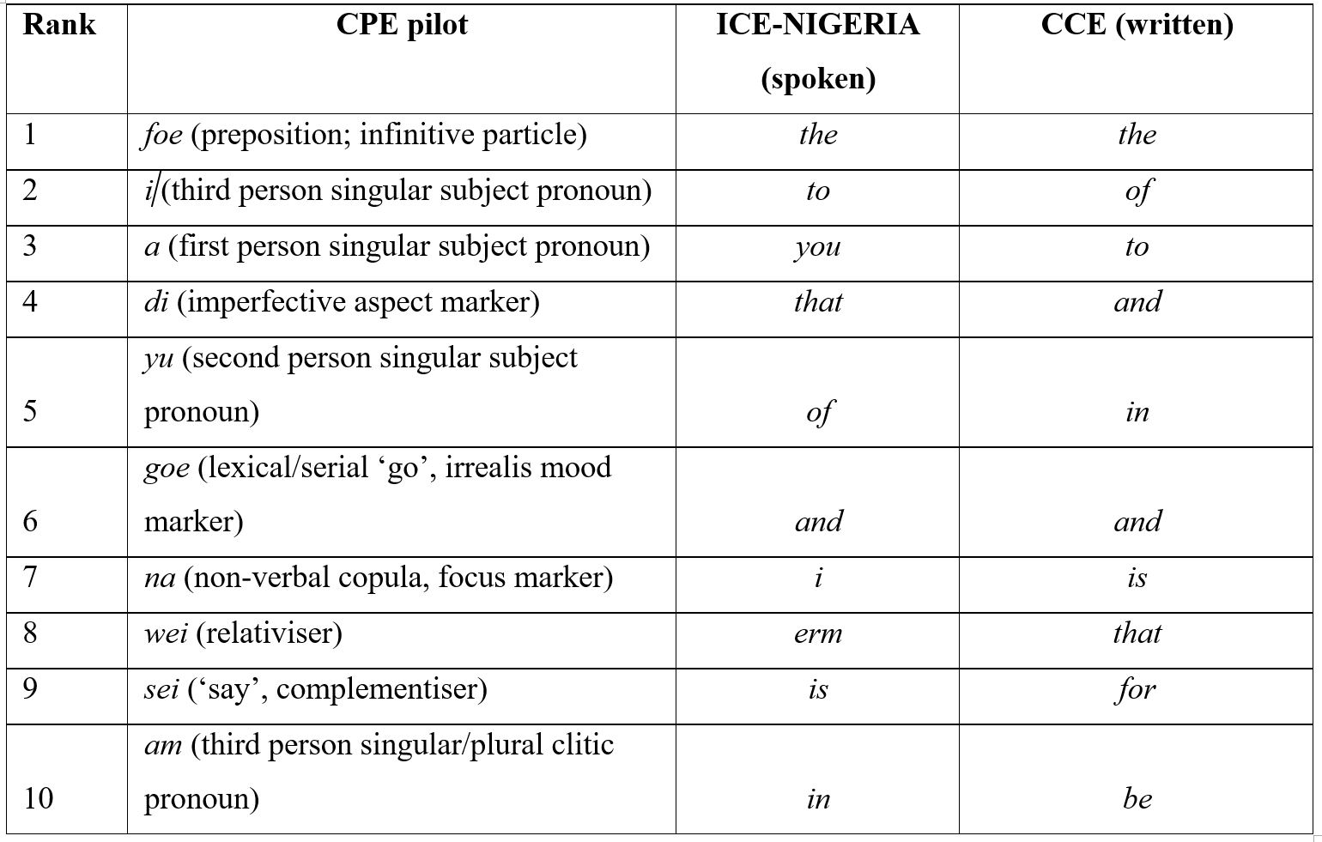
Lexis: most frequent word queries
(CPE, CCE, ICE-NIGERIA)
Most frequent words in spoken CPE, spoken ICE-NIGERIA and written Cameroon English
Ozon et al (2017)
Notes:
CPE list is (predictably) heavily populated by grammatical elements such as determiners, pronouns and
tense/aspect/mood/modality markers
In CPE, the most frequent word is foe, by far the most frequent preposition in CPE, whereas both CCE and ICE-NIGERIA have a number of prepositions in the top 10 (to, of, in, for).

Slide 22
Codeswitching
The language of the corpus texts is CPE, with codeswitching into English, French, and indigenous Cameroonian languages
Instances of codeswitching can be identified by searching for the mark-up identifiers <foreign> and <indigenous>
By combining mark-up information with metadata, we can find out:
  who codeswitches (age, gender, etc.)
  where is codeswitching more frequent (region)
Notes:
The grammatical and social dimensions of CS are complementary to each other (e.g. Gumperz 1967, Poplack 1980)
CS due to necessity and CS as the product of choice are not always easy to separate. Many instances of CS are combinations of the two, or somewhere on the border between the two (Gardner-Chloros 2012:106).

Slide 23
Codeswitching by sociolinguistic variable
CS corresponds with a wide range of sociolinguistic factors that interact or operate simultaneously. We should therefore be wary of ascribing particular “reasons” to particular instances of CS, as these are likely to present only a partial picture (Gardner-Chloros 2012:113)
Region: Codeswitching more frequent in large, metropolitan areas; correlation with population size (Do>Ya>Ba>Ku>Be)
L1: Francophones are fewer in the CPE corpus, yet they codeswitch more than Anglophones
Gender: Males appear to codeswitch proportionally more than females
Age: Inconclusive (still, CS appears to be a young(ish) phenomenon, mostly in the language of those aged 22-34)
Notes:
-Formal features
-QUAN perspective (amenable to CS as necessity)
-Cross-sectionally

Slide 24
Language use: Social meanings
“[The] use of particular linguistic forms does not always signal the same underlying motivations” (Gardner-Chloros 2012:108).
Multilingualism
a panacher Anglais, Pidgin, Ngusan, tout a panacher… Kamerun na bilingual kontri wuna bigin tok am (Be_DPu_01)
‘Mixing English, Pidgin, Ngusan, everything, mixing it all up … Cameroon is a bilingual country, you start speaking them.’
Functions
an foe foe preich de wok of God foe kogrikrishon i bi fain foe preich am foe Pidgin inglish … soe dat meik de lis man goe ondastan ting wei dey di tok (Be_Mu_02)
‘And to preach the word of God to the congregation, it’s good to preach it Pidgin English … so that allows the humblest man to understand what they’re saying.’
i bi sei, a di wan tok som ting wei i noe bi hidin, a tok de ting (Ku_MU_04)
‘It’s that, if I want to say something openly, I say it [in Pidgin].’
Notes:
-Functional features
-QUAL perspective (amenable to CS as choice)
-Longitudinally

Slide 25
Language use: Social meanings
Age
alis if yu tok Pidgin, alis big mama wei i deiy foe vileich i mus ondastan ting wei yu di tok (Be_Mu_02)
‘At least, if you speak Pidgin, at least the elderly women in the village will understand what you’re saying.’
Pikin dem foe nau soe, dey goe tok wan English o Pidgin, foe kontri tok dey noe fit tok (Ku_MU_04)
‘The youth of today, they speak only English or Pidgin, they can’t speak their indigenous languages.’
Stigma
from childhood dey meik mi foe ondastan sei Pidgin, Pidgin na bad laguech … Yu tok Pidgin foe haus dey bit yu, yu goe skul yu tok Pidgin dey bit yu (Ya_MU_03)
’From childhood, they taught me that Pidgin, Pidgin was a bad language … You’d speak Pidgin at home, they’d beat you, you’d go to school and speak Pidgin, they’d beat you”

Slide 26
Next steps
Release of CPE corpus, version 2
  Corrections in orthography, mark-up, POS tags
  Improved access to participant information data
New bid for 1,000,000-word corpus of spoken CPE
  Scaling up processes (and tools)
  Including five teams in Cameroon, with five recording locations
  More variation, increasing representativeness, comparability and balance
Ongoing research strands
  Grammar
  Lexis
  Prosody, tone
  Codeswitching

Slide 27
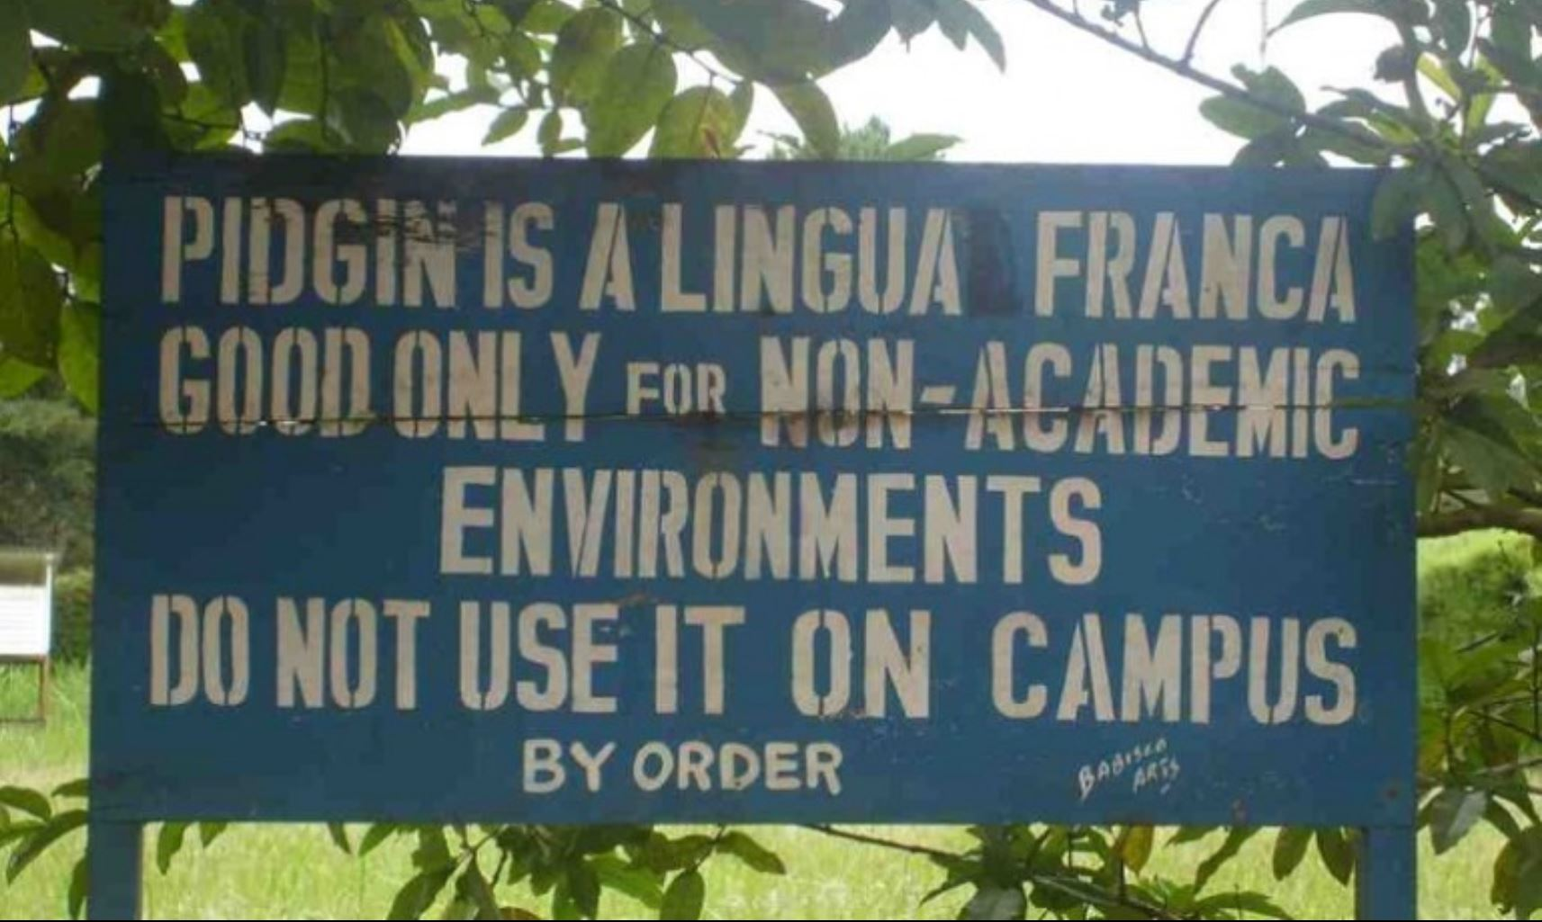
Thank you
We acknowledge the support of British Academy/Leverhulme grant (ref. SG140663) A spoken corpus of CPE: Pilot study
‘i fain foe tok pidgin bikos yu fit goe foe som pleis wei dey noe di hie dat big big grama o dat big big French’ (Be_Mu_02)
‘It’s good to speak Pidgin because you might go somewhere where they don’t speak Standard English or Standard French’

Slide 28
References
Ayafor, Miriam and Melanie Green. 2017. Cameroon Pidgin English [London Oriental and African Language Library]. Amsterdam: John Benjamins.
Bruyn, Adrienne. 2009. Grammaticalization in creoles: ordinary and not-so-ordinary cases. Studies in Language 33: 312–337.
Gardner-Chloros, Penelope. 2012. Sociolinguistic factors in code-switching. In Bullock, Barbara & Jacqueline Toribio Almeida (eds.). The Cambridge handbook of code-switching. Cambridge: Cambridge University Press, 97-113.
Garside, Roger (1987). The CLAWS Word-tagging System. In R. Garside, G. Leech and G. Sampson (eds.), The Computational Analysis of English: A Corpus-based Approach. London: Longman.
Green, Melanie. 2007. Focus in Hausa. [Publications of the Philological Society 40]. Oxford: Blackwell.
Green, Melanie, Miriam Ayafor and Gabriel Ozón. 2016. A spoken corpus of Cameroon Pidgin English: pilot study. British Academy/Leverhulme funded project (http://ota.ox.ac.uk/desc/2563 )
Green, Melanie and Gabriel Ozón. 2018. Information structure in a spoken corpus of Cameroon Pidgin English. In Evangelia Adamou, Katharina Haude and Martine Vanhove (eds.), Information structure in lesser-described languages: Studies in prosody and syntax. Amsterdam: John Benjamins. 329–355.

Slide 29
References
Harris, Alice C. 2001. Focus and universal principles governing simplification of cleft structures. In Jan Terje Faarlund (ed.) Grammatical relations in change. Amsterdam: John Benjamins: Amsterdam. 159-170.
Harris, Alice C. and Lyle Campbell. 1985. Historical syntax in cross-linguistic perspective. Cambridge: Cambridge University Press.
Heine, Bernd and Tania Kuteva. 2005. Language contact and grammatical change. Cambridge: Cambridge University Press.
Michaelis, Susanne Maria & Maurer, Philippe & Haspelmath, Martin & Huber, Magnus (eds.) 2013. The Atlas of Pidgin and Creole Language Structures. Oxford: Oxford University Press.
Nelson, Gerald. 1996. The design of the corpus. In Sidney Greenbaum (ed.). Comparing English worldwide. The International Corpus of English. Oxford: Clarendon Press, 27–35.
Nelson, Gerald. 2002. Markup manual for spoken texts. Available online at www.ice-corpora.uzh.ch/dam/jcr:72c70d5a-8da8-496f-b8dc-5fb66986c87c/spoken.pdf.
Nkemleke, Daniel and Paul Mbangwana. 2007. Manual of information to accompany the corpus of Cameroonian English. Chemnitz: Department of English, Chemnitz University of Technology, Germany.
Ozón, Gabriel, Melanie Green, Miriam Ayafor and Sarah FitzGerald. 2017. Building a spoken corpus of Cameroon Pidgin English: methodological challenges. World Englishes 36(3): 427–447.

Slide 30
References
Ozón, Gabriel, Sarah FitzGerald and Melanie Green. Forthcoming, 2019. Addressing a coverage gap in African Englishes: the tagged corpus of Cameroon Pidgin English. In Esimaje, Alexandra, Ulrike Gut & Bassey Antia (eds.) Corpus Linguistics and African Englishes. Amsterdam: John Benjamins, 143-164.
Schmid, Helmut. 1994. Probabilistic Part-of-Speech Tagging Using Decision Trees. Available online at http://www.cis.uni-muenchen.de/~schmid/tools/TreeTagger/data/tree-tagger1.pdf.
Schroder, Anne. 2013. Cameroon pidgin English structure dataset. In Susanne Maria Michaelis, Philippe Maurer, Martin Haspelmath & Magnus Huber (eds.), Atlas of pidgin and creole language structures online. Leipzig: Max Planck Institute for Evolutionary Anthropology. http://apics-online.info/contributions/18.
Sebba, Mark, Sally Kedge and Susan Dray. 1999. The Corpus of Written British Creole: a User’s Guide
Simons, Gary F. and Charles D. Fennig (eds.). 2017. Ethnologue: languages of the world. 20th edition. Dallas, Texas: SIL International. Online version: http://www.ethnologue.com.
Tiomajou, David. 1993. Designing the corpus of Cameroon English. ICAME Journal 17. 119–124.
Wunder, Eva-Maria, Voormann, Holger and Gut, Ulrike. (2010). The ICE Nigeria corpus project: Creating an open, rich and accurate corpus. ICAME Journal 34, 78-88.

